Slide 1
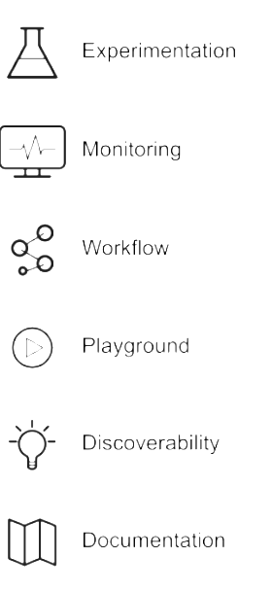

Design Patterns Of Data Science platform

Slide 2
To Be Defined
To Be Defined

